Slide 1
Evaluating LLM Program Synthesis on PonyLang
First evaluation of LLM code generation for a capability-based actor-model programming language
Nicholas Zayfman (nzayfma1@jh.edu)

Slide 2
Motivation
Project in undergrad Programming Languages Course -> code distributed Matrix Calculator in PonyLang
LLMs excel at mainstream languages (Python, Java, JavaScript, C++)
Gap: Performance on niche languages with advanced type systems (as well as actor-based models with reference capability) is largely unexplored.
Why PonyLang?
Actor-model language with unique reference capabilities (iso, trn, ref, val, box, tag)
Challenge: Memory safety and data-race freedom enforced at compile-time
Research Objectives: Benchmark LLM code synthesis capabilities for PonyLang
Key Questions:
Which prompting strategies work best?
How do LLMs handle Pony's unique features?
Where do capability-based type systems break LLM performance?

Slide 3
Methodology
Dataset: 12 tasks across 4 categories
Basic Syntax, Actor Concurrency, Reference Capabilities, Complex Systems
4 difficulty levels (easy → expert)
Prompting Strategies: 10 approaches (Zero-shot, Few-shot, Chain-of-thought, Self-debug, Transfer-Rust, Capability-focused, Actor-focused, Contrapositive, Analogical, and Expert persona).
Evaluation: Google Gemini 2.5 Flash (temp = 0.7) and automated compilation testing
Total: 120 code generation attempts (3.5 hr runtime)

Slide 4
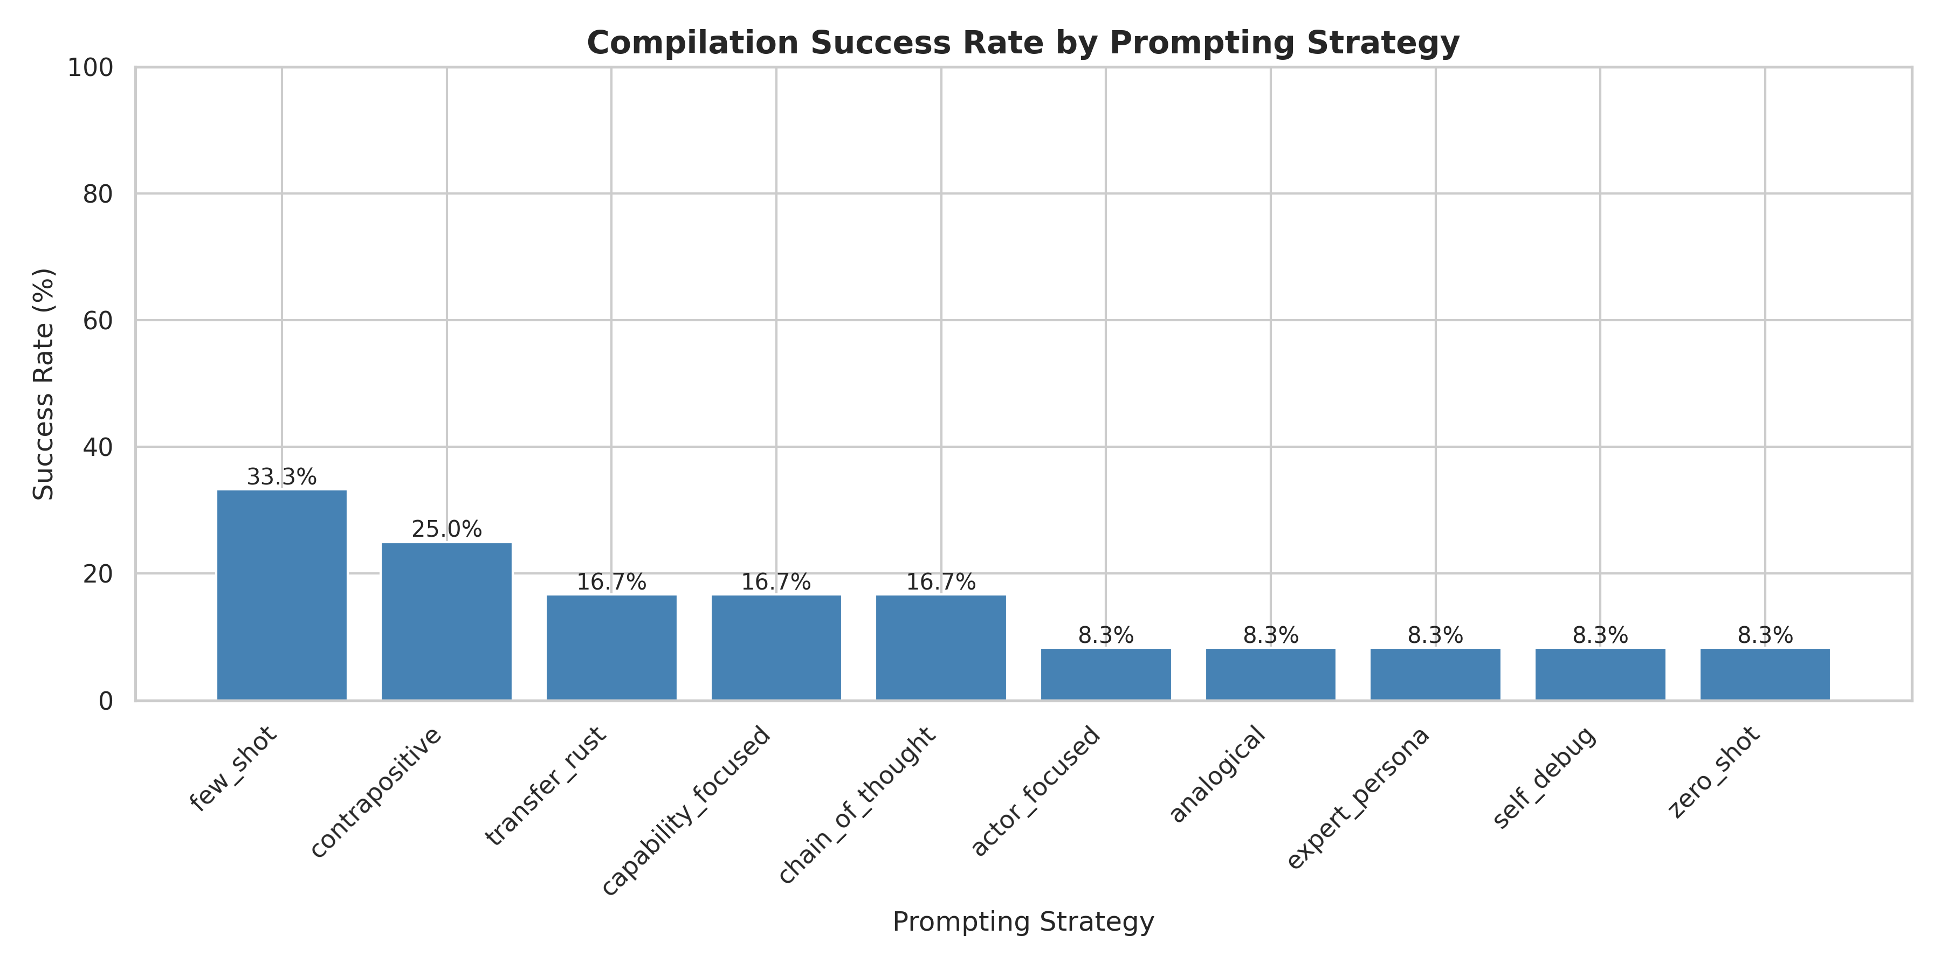
Key Findings
Overall Success Rate: 15% (18/120 compilations)
Few-shot prompting dominates at 33.3%
More sophisticated strategies such as (expert persona, chain-of-though, self-debug) surprisingly underperform.
Insight: Pattern recognition

Slide 5
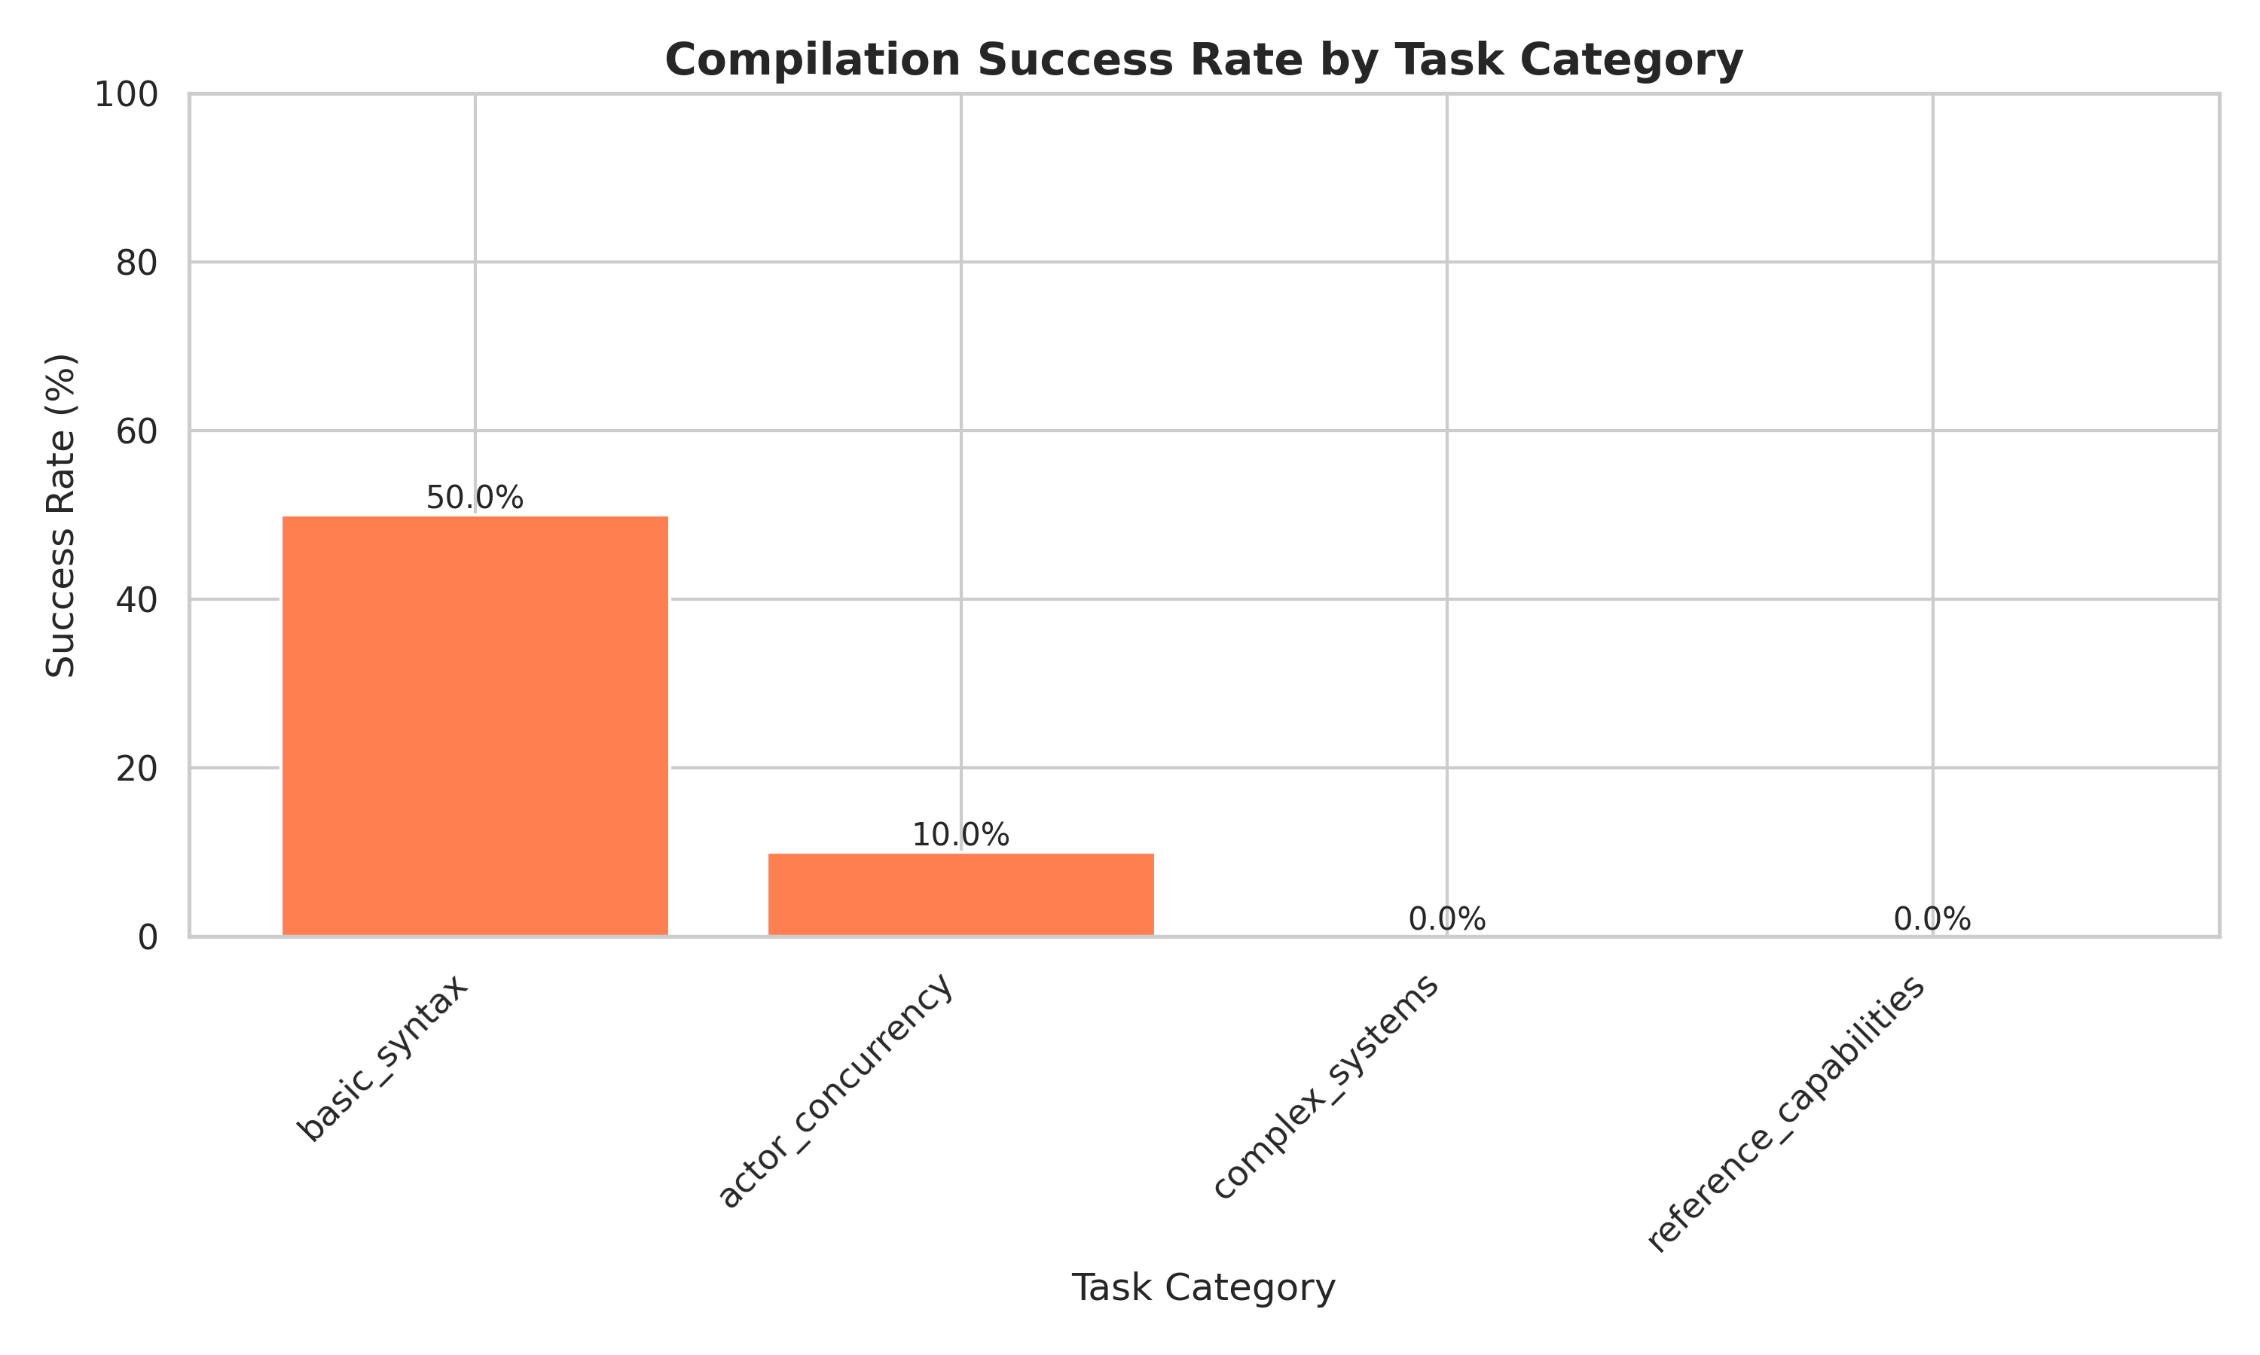
Results by Task Category
Basic Syntax: 50% Success
Actor Concurrency: 10% Success
Reference Capabilities: 0% Success
Complex Systems: 0% Success
Insight: LLMs learn surface syntax but fail at capability reasoning.

Slide 6
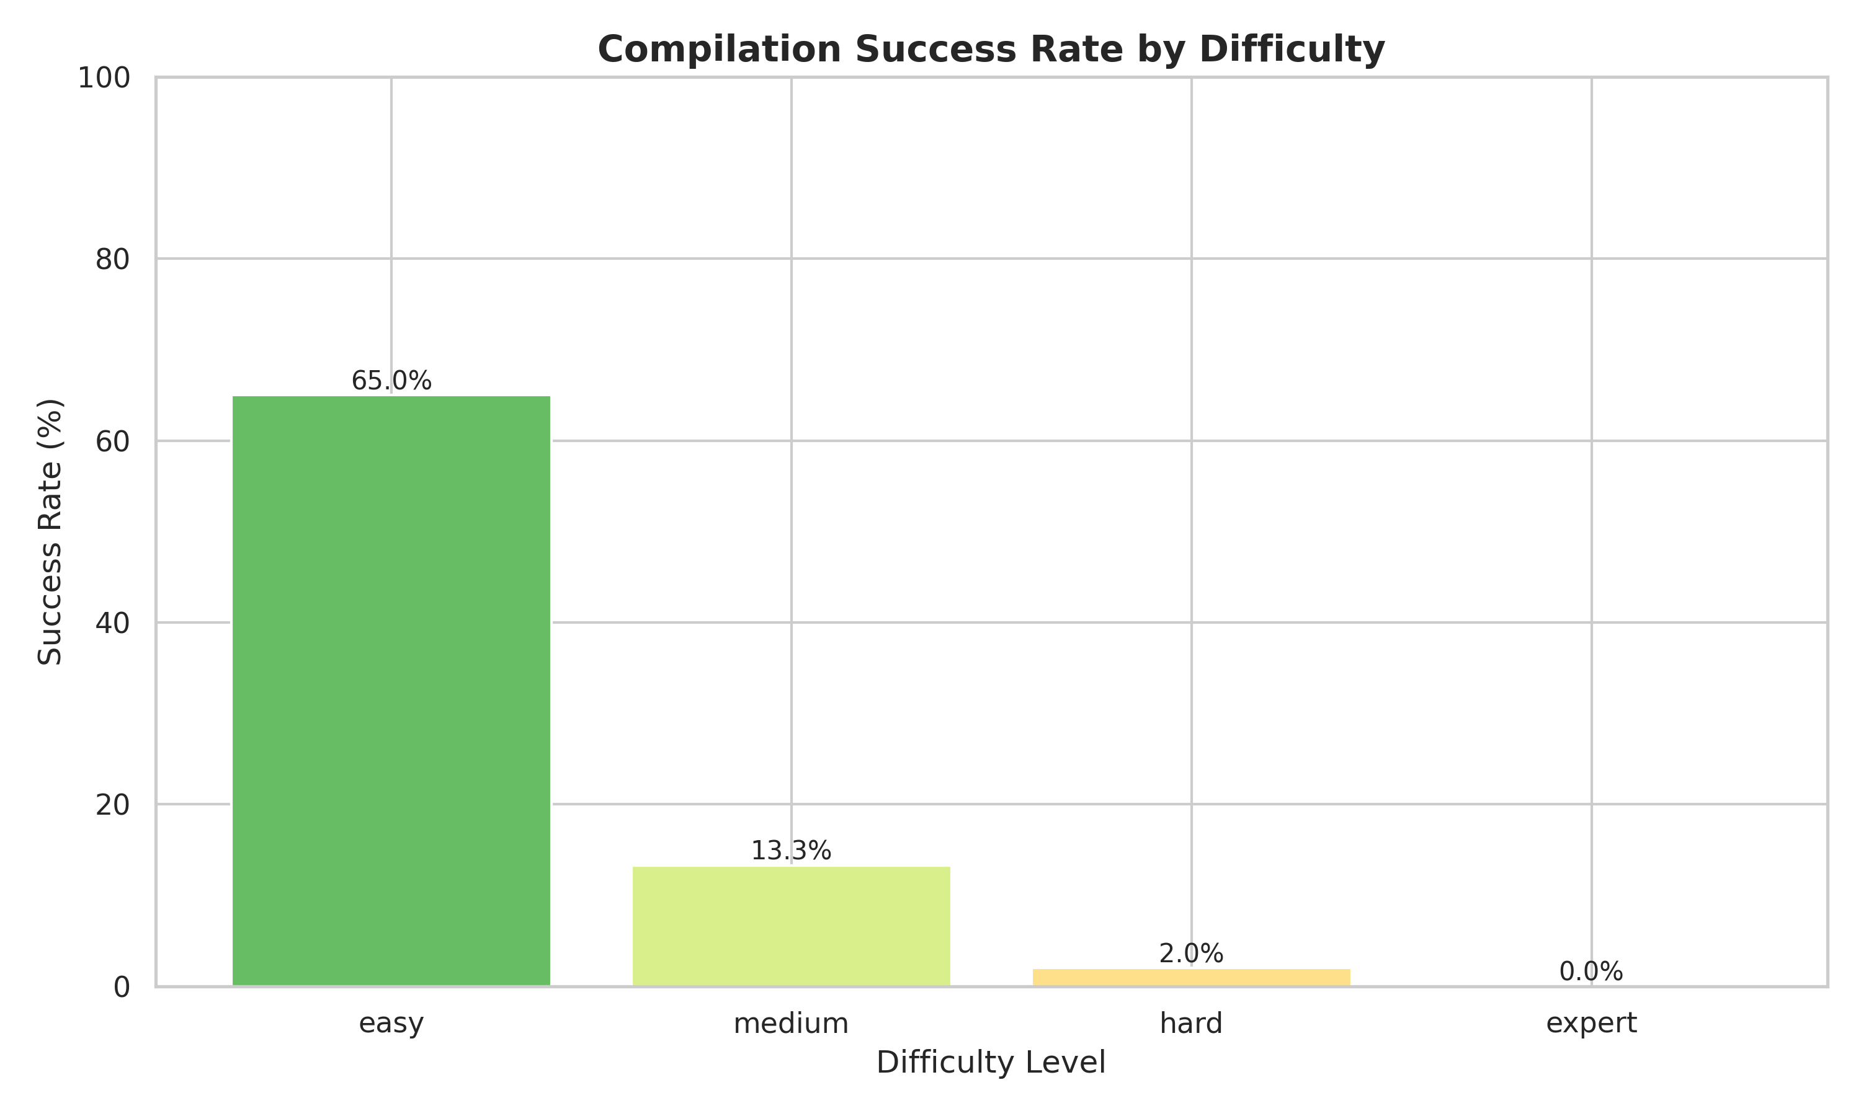
Results by Difficulty
Easy Tasks: 65% Success
Medium Tasks: 13.3% success
Hard Task: 2.0%
Expert Task: 0.0%
Pattern matching works for simple tasks, but semantic understanding is missing.

Slide 7
Conclusion and Future Work
Main Takeaway: LLMs struggle fundamentally with advanced type systems
Key Contribution: First PonyLang benchmark establishing baseline
Future Directions:
Multi-model ensembles
Retrieval Augmented Generation (RAG)
Compiler-in-the-loop strategies
Neurosymbolic approaches (LLM + formal methods)
Fine-tuning on capability-based languages
Scale to 50+ task benchmark
Implement Verona and Erling/Elixir and test on more models GPT, Claude Opus, etc.
Broader Impact: Insights applicable to other niche/advanced type system languages

Slide 8
Thank you.

Slide 9
Copyright The Johns Hopkins University 2025. All rights reserved.

